Slide 1







Space X Falcon 9 First Stage Landing Prediction
Christopher Nindyo
10 Oktober 2022

Slide 2



OUTLINE
Executive Summary
Introduction
Methodology
Results
Visualization – Charts
Dashboard
Discussion
Findings & Implications
Conclusion
Appendix

Slide 3

EXECUTIVE SUMMARY
This report analyzes how data science can predict the SpaceX landing
To answer this problem, we look it as problem that can be solved with collected data from the past and then solve them with machine learning
Our results showed that we can predict with machine learning model with accuracy 83% to tell which the launch is success or not
From safety reason, this study also showed that the launch site far from city but people can still reach the site.

Slide 4

INTRODUCTION
We will predict if the Falcon 9 first stage will land successfully
If we can determine if the first stage will land, we can determine the cost of a launch

Slide 5

METHODOLOGY
Data Collection from SpaceX REST API
Cleansing the data to be ready analyized
Exploratory Data Analysis (EDA) to find some patterns in the data and determine what would be the label for training supervised
Visualization of the relationship between the variables of Space X Dataset
Finding an optimal location for building a launch site
Determine the best model for Space X Falcon 9 First Stage Landing Prediction

Slide 6
RESULTS

Slide 7
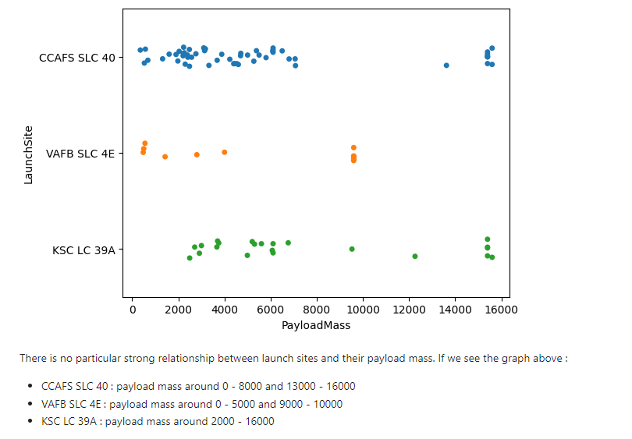
The relationship between Payload and Launch Site

Slide 8
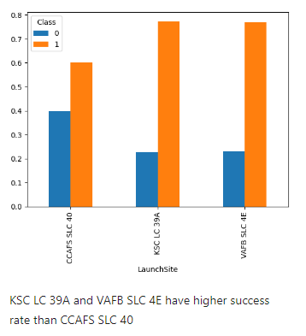
The relationship between success rate of each orbit type

Slide 9
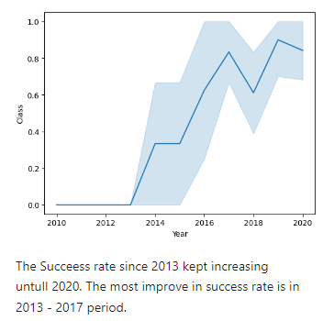
The launch success yearly trend

Slide 10
EDA WITH SQL

Slide 11
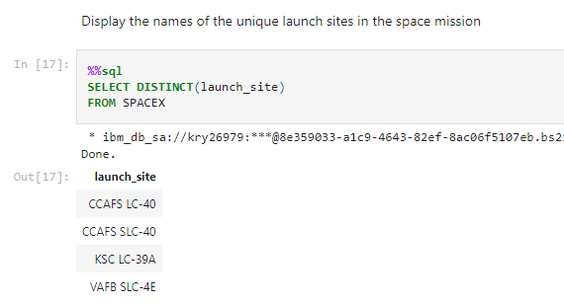

Slide 12
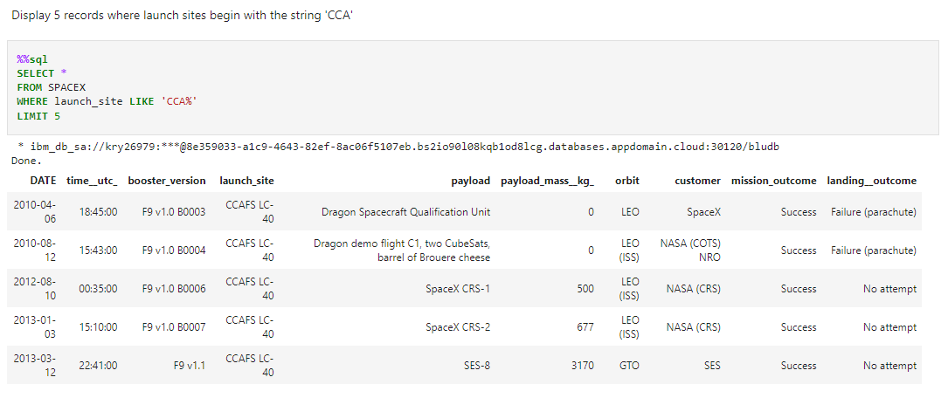

Slide 13
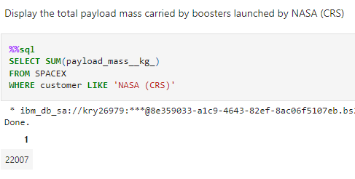

Slide 14
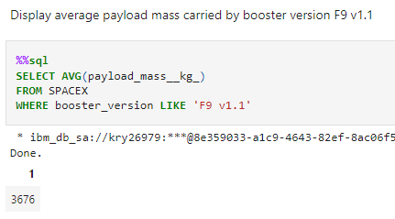

Slide 15
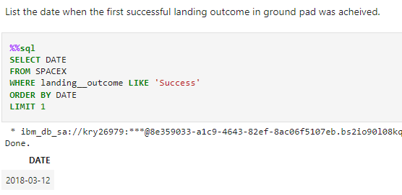

Slide 16
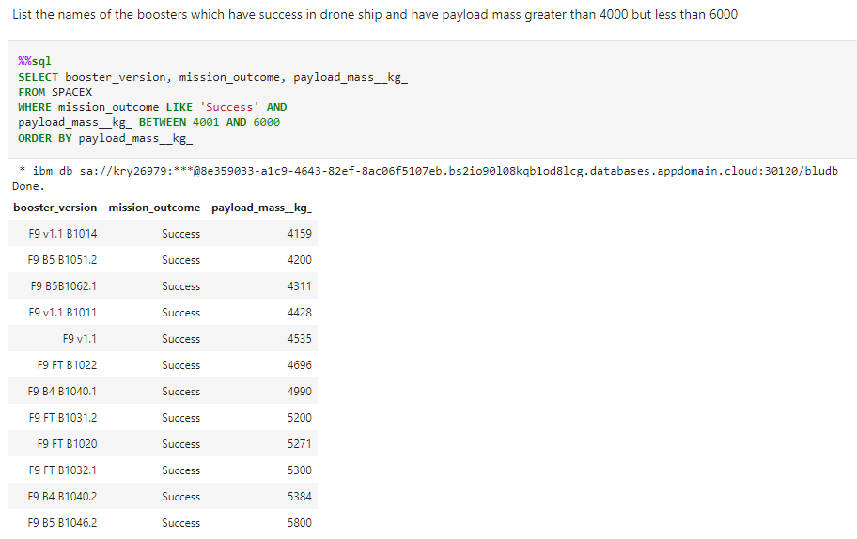

Slide 17
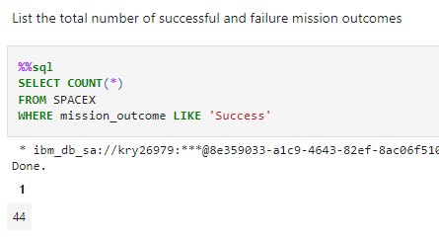
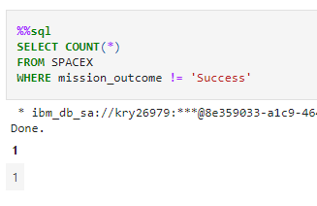

Slide 18
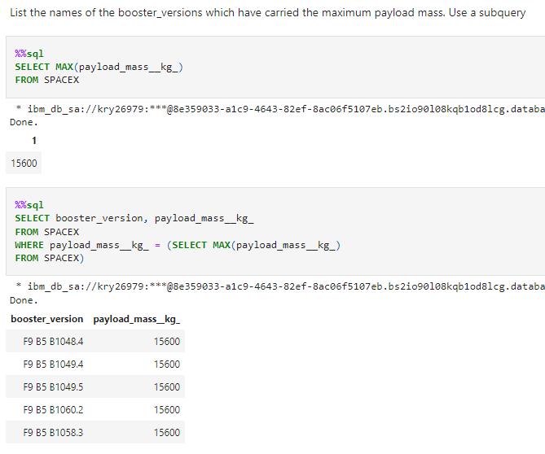

Slide 19
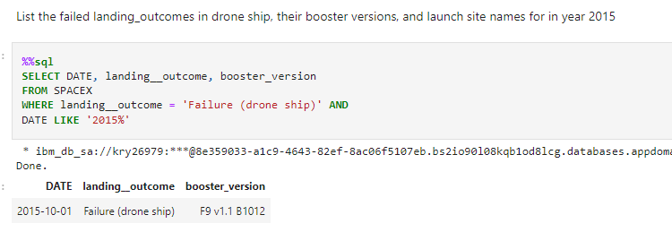

Slide 20
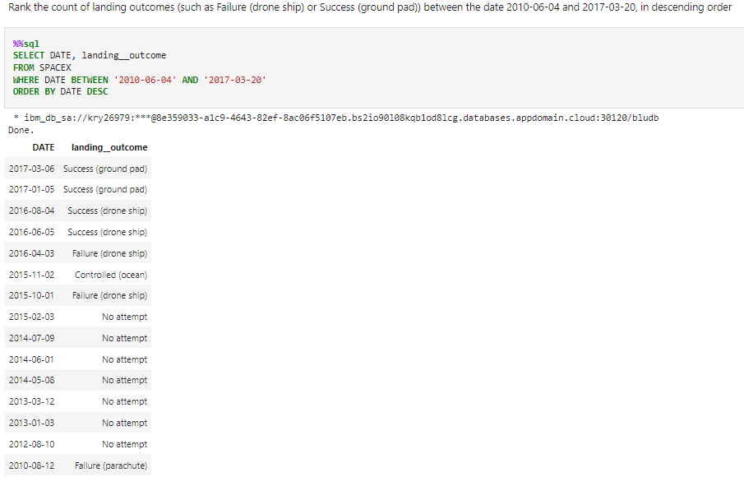

Slide 21
ANALYSIS WITH FOLIUM

Slide 22
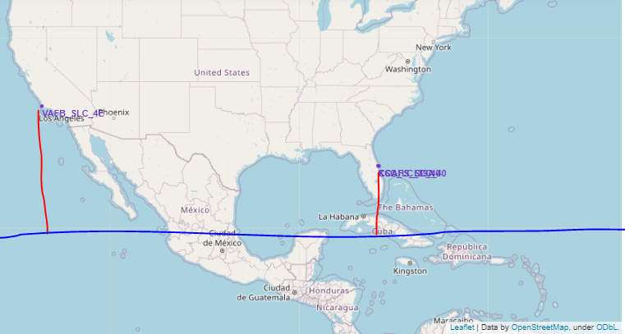
Location of Launch Sites

Slide 23
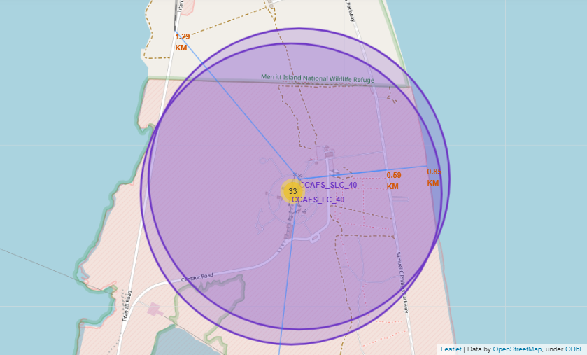
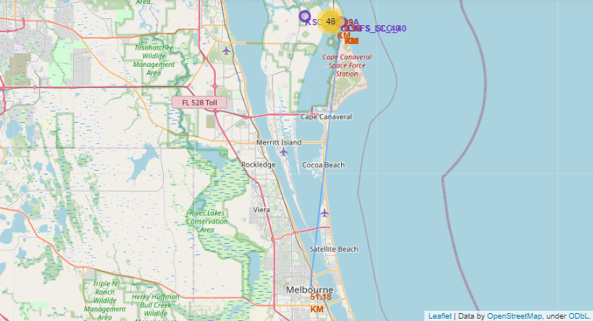

The Closest to Railways, Highways, Coastline, and City

Slide 24
dashboard
Link for interactive dashboard :
https://github.com/ChristoNindyo/SpaceX-Interactive-Dashboard/blob/main/Build%20an%20Interactive%20Dashboard%20with%20Ploty%20Dash.ipynb

Slide 25
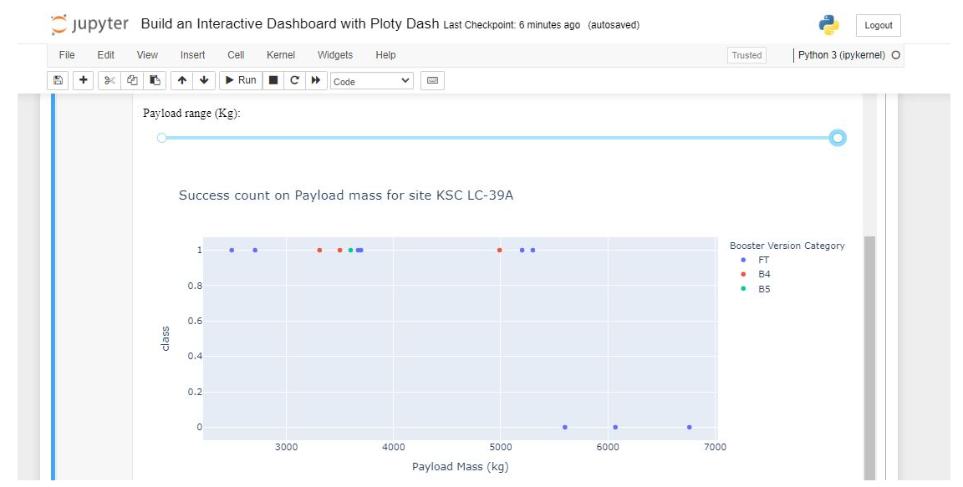

Slide 26
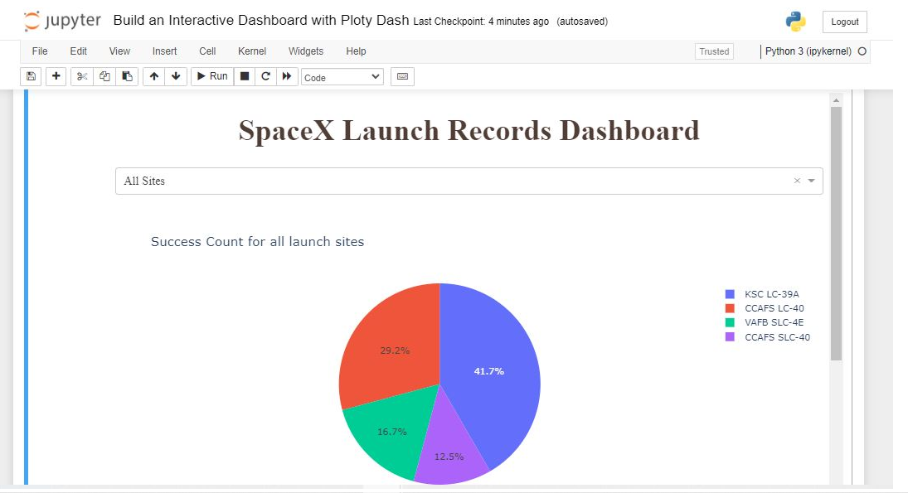

Slide 27
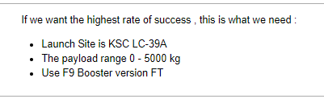
Based on the dashboard

Slide 28
MACHINE LEARNING

Slide 29
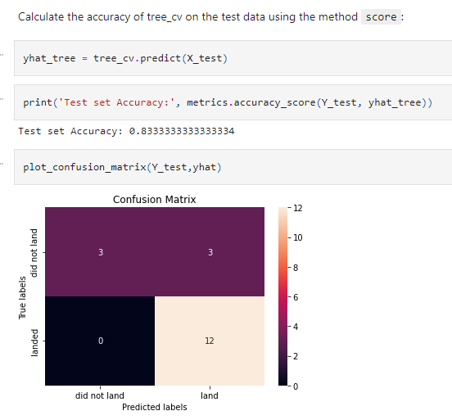
The Best Model we got
Decision Tree
Accuracy : 83,34 %

Slide 30

DISCUSSION
Do Data Science actually help in this problem ?
Is accuracy of our model is good enough ? If not, how can we improve ?
How business environment we should make to get the best result ?

Slide 31

CONCLUSION
In this particular problem, Data Science help to deconstruct the main problem to sub problem. So, we can analyze easier and faster
We can solve this problem without complex rocket science but with data analysis & machine learning
We get what parameter that make the launch get most success
We get model to deploy to determine launch which success or not

Slide 32

APPENDIX
Coursera Data Science Program by IBM
Data Science for Business book by Provost and Fawcett
Business Analytics book by Camm, Cochran, Fry, Ohlmann, Anderson, Sweeney, and Williams

Slide 33
Thank you

